Slide 1

SNOWFLAKE
Bookly customer support agent
Suresh Vadakath

Slide 2
Agent Design
Key criteria
You're building a customer support chat or voice AI agent for Bookly, a fictional online bookstore. Customers contact support for:
Order status inquiries
Return/refund requests
General questions about shipping, policies, password reset, etc.
Prototype
Build a simple interactive demo that shows your agent in action. Users should be able to type or speak queries and receive responses.
Minimum requirements
At least one multi-turn interaction (e.g. collecting information before
responding)
At least one example of the agent taking an action or using a tool (real or
mocked)
At least one case where the agent chooses not to answer immediately and instead asks a clarifying question

Slide 3
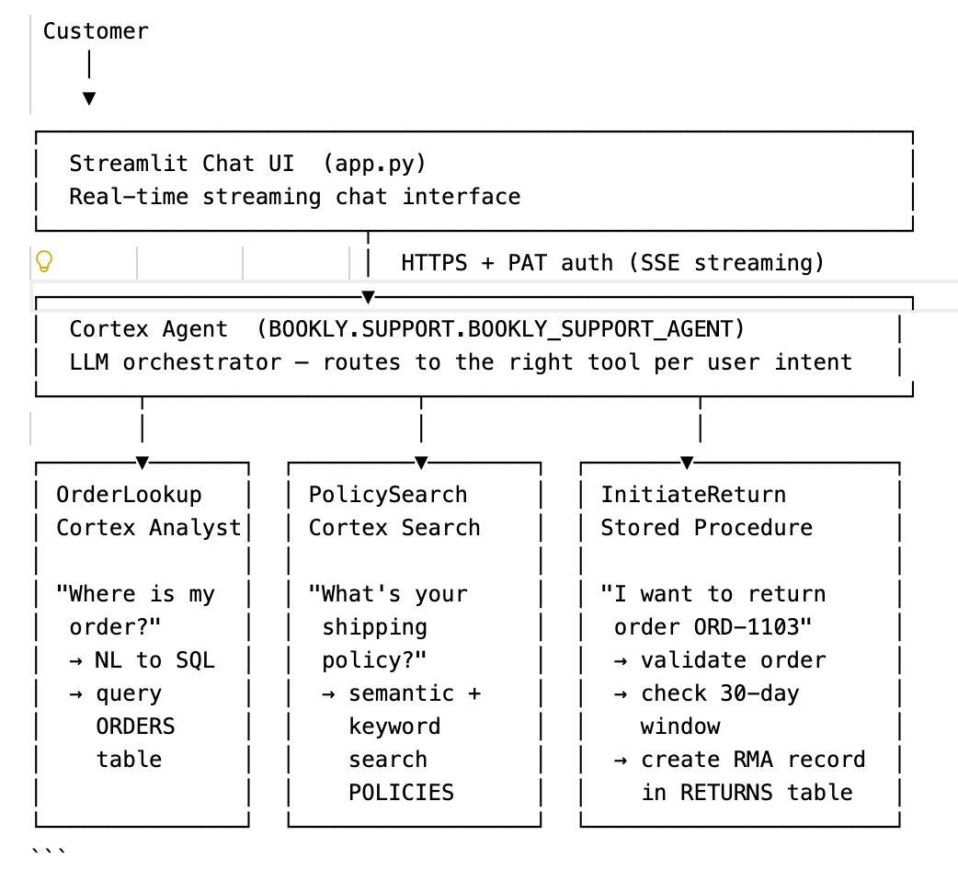
Customer Support Agent Architecture
A conversational AI customer support agent for **Bookly** (online bookstore) that can answer order questions, look up policies, and process returns — all powered by **Snowflake Cortex** with a **Streamlit** chat UI. See Cortex Agent docs

Slide 4








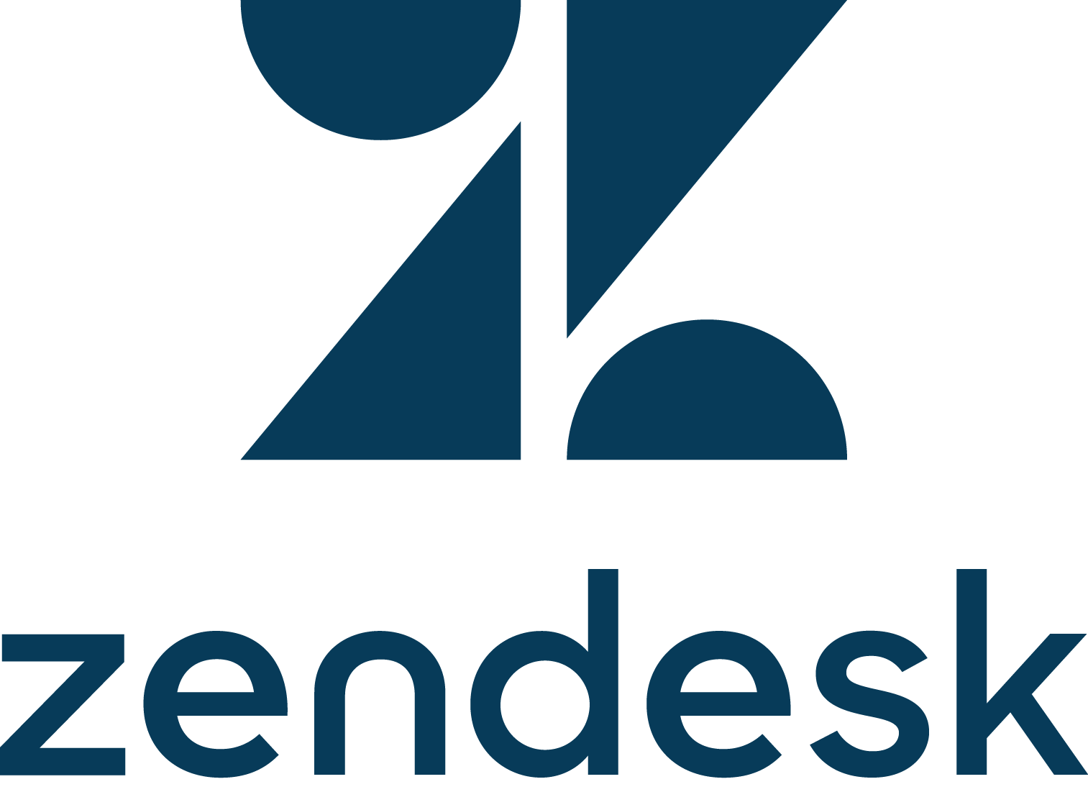

















Snowflake Cortex AI is Easy, Connected, Trusted
SNOWFLAKE CORTEX AI
AGENTIC BUSINESS INSIGHT
MODELS
GOVERNANCE
Agent Apps
Snowflake Intelligence
Agent APIs
Cortex Agents
RBAC
Guardrails
STATE OF THE ART RETRIEVAL
Unstructured Data Retrieval
Cortex Search
Structured Data Retrieval
Cortex Analyst
Evaluations
Monitoring
SCALABLE AI PROCESSING
Structured Data Retrieval
Cortex Analyst
Multimodal AI-powered SQL
Cortex AISQL
Document Processing
Document AI, Parse, Embed
AI Gateway
STR
DOC
AUDIO
IMAGE
DATA INGESTION
Fully managed extraction, load, preprocess, and activation of multimodal data

Slide 5
How does Cortex Analyst work?
User asks support question
Cortex Analyst determines if the question can be answered
If yes, we generate a SQL
query and provide the answer
If no, we explain why and provide
follow-up or alternative questions they can ask

Slide 6
How does Cortex Analyst work?
Cortex Analyst uses a “Semantic View” to generate SQL
The admin sets up a “Semantic View” using the generator in Snowsight.
The end user asks questions in natural language
Cortex Analyst uses the user question and semantic view to generate SQL

Slide 7
What is a Semantic View?
A Semantic View in Cortex Analyst is a mapping between business terms and underlying data model
1. Logical Tables
2. Metrics and Filters
3. Relationships
Represents business entities like Customers, Orders, Products, Time
Contains:
Dimensions (e.g., Product Name, Customer Region)
Time Dimensions (e.g., Order Date, Shipping Time)
Facts (e.g., Order Quantity, Price)
Metrics: Predefined calculations (e.g., Total Revenue = SUM of net sales)
Filters: Quick conditions to narrow results (e.g., Only North America)
Define joins between tables (e.g., Orders joined to Customers on customer_id)
Notes:
Apart from Cortex Analysts’ sophisticated agentic setup, a key pillar for Cortex Analysis high accuracy is the user provided semantic model. This is typically set up by someone on the data team.
Think of an LLM alone as a super smart analyst who is new to your data organization. They often lack the semantic context about the nuances of your data given only the raw schema, it's challenging for any analyst to write SQL accurately to answer business users data questions. Raw schemas are often messy and lack the semantic information needed for accurate data analysis.
In a physical database, a column representing product categories might be abbreviated and labeled as “Cat”. However, a business user might refer to the same data as “product category” or “product segment” when asking a question. Without a semantic model to bridge this gap, LLMs will struggle to recognize that these different terms all refer to the same piece of data, leading to potential inaccuracies in the analysis.
Physical data schemas tend to be comprehensive. A raw table may include multiple versions of sales numbers, while you only want to represent one version to your end business users.
A semantic model addresses these issues by allowing the data team to:
Specify additional semantic details about the data set. This might include more descriptive names, synonyms free from descriptions of tables and columns, or even instructions on how certain data should be used. These details enable Cortex Analysts to bridge the gap between business users vocabulary and the raw database schema, resulting in more accurate responses,
Perform data modeling by exposing only the relevant columns and define common metrics and set filtering conditions.

Slide 8
Cortex Search : Fully Managed Indexing and Retrieval
User Query
Hybrid Retrieval
Result Set
RESULT_1:
“Prescribed with Topaz 10 mg starting from 10/2/2022 to Alex Mander…”
RESULT_2:
“ 10 milligrams of per day day Topaz alongside Allegra to Junie Monza...”
RESULT_K:”...”
Query:
“Who are the patients prescribed with a daily dosage of 10 mg Topaz”
Filter:
“Year = 2022”
Semantic Lookup
Keyword / Lexical Lookup
Result Fusion
and Reordering
Documents

Slide 9
Agentic Orchestration (Cortex Agents API)
Reasoning
Query…
Planning
Memory
Task Decomposition
Query Rewrite
Short-term
How do I improve margins?
Chain of Thought
Self-Critique
Long-term
How can I help?
Answer
Tool Use
Structured
Data Retrieval
Unstructured Data Retrieval
Coding
Web
Search
Visualization
Other Tools (MCP)
Other Agents (A2A)
Custom
Tools …
Reflection
YES
Do I have all the information to
answer the user query accurately?
NO

